Slide 1
When AI Meets Fashion:
Multiclass Trend Prediction Using Fashion-MNIST
Team Members: Zoe Marshall | Bibek Dhungana |
Saanjali Majmundar | Lingxin Chen | Aliya Eissa
Notes:
Zoe

Slide 2
Project Goals
1. Build a system that can reliably recognize different kinds of clothing in images
Analyze different classifying algorithms for best performance
2. Build a pipeline between real-world camera- captured images and Fashion-MNIST dataset in be able use our training information
Notes:
Zoe

Slide 3
Why do we care what are we trying to solve
1. Search & Recommendation
Visual search
Similar-item matching
2. Automation & Inventory
Catalog labeling
Warehouse sorting
Retail tracking
3. AR & Environment
Virtual try-on
Smart home sensing
Clothing-aware interfaces
Notes:
Ling
We care about this because clothing classification supports many real applications.
For search and recommendation, it helps visual search and matches similar clothing items.
For automation and inventory, it makes it easier for retailers to label, sort, and check different catalogs.
And for AR environments, it’s the foundation for virtual try-on and interfaces that react to what someone is wearing.
So this task connects directly to real-world use cases.

Slide 4
What did we do and compare to what's done
Typical approach:
Binary classifiers (One-vs-Rest)
Uses raw pixel values
Limited performance, not very flexible
What we added:
Softmax logistic regression
PCA feature reduction
RBF feature mapping is an alternative
Why it helps:
Softmax handles all 10 classes at once
PCA reduces noise and speeds training
RBF adds nonlinearity for harder cases
Notes:
Aliya
What's new in your approach and why do you think it will be successful?
How is it done today, and what are the limits of current practice?
# we introduced softmax, instead of doing binary, then one vs rest and one vs one. So, accuracy was increased and output was probabilistic
# Introduced favor of PCA and other RBF basis alternatives.
for our project, we looked at how clothing classification is normally done and how our approach improves on some of the limitations.
A lot of earlier models treat Fashion-MNIST as ten separate binary classification problems.
You train one model per class, either one-vs-rest or one-vs-one.
This works, but it is slower, less stable, and it does not naturally give you class probabilities.
Instead, we used softmax logistic regression, which handles all ten classes in a single model.
This ended up giving us better accuracy and clearer probabilistic outputs.
We also experimented with two different feature representations. First, we used PCA to reduce the data to 100 components. This makes the model faster, less noisy, and more generalizable. Second, we introduced an RBF basis mapping, which lets the logistic regression model create more flexible nonlinear decision boundaries. So overall, our contribution was showing that softmax combined with PCA or RBF features leads to a more efficient and accurate approach than the traditional binary methods

Slide 5
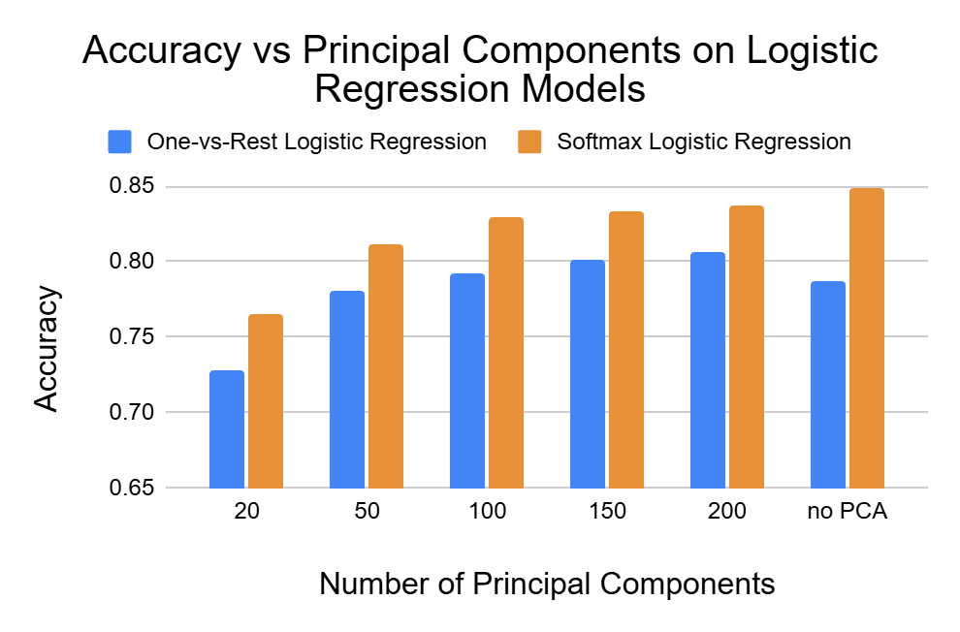
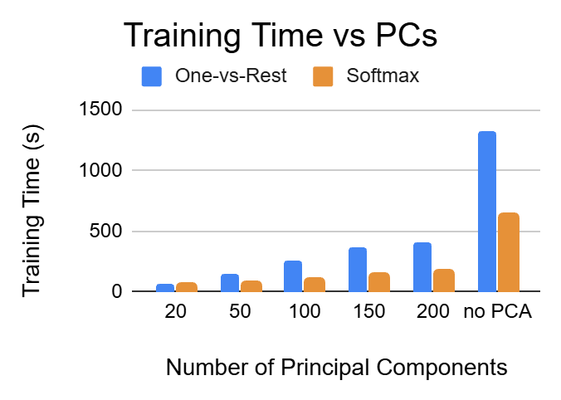
Results - PCA
Accuracy Improvement: Softmax Model significantly outperforms One-vs-Rest model
  83.7% with 200 PCs
Computational Efficiency:
  OvR Training: 1328 s → 408 s
Notes:
Saanjali
Probabilistic model for multiclass classification is more effective than multiple independent binary classifiers
Softmax is fast because it learns all class probabilities simultaneously. Compute single matrix multiplication, but OvR runs 10 classifiers for every test sample (longer but still 3x faster)
PCA trades small amount of accuracy for efficiency
This was trained on the regular MNIST but can the models perform when images are further modified?

Slide 6
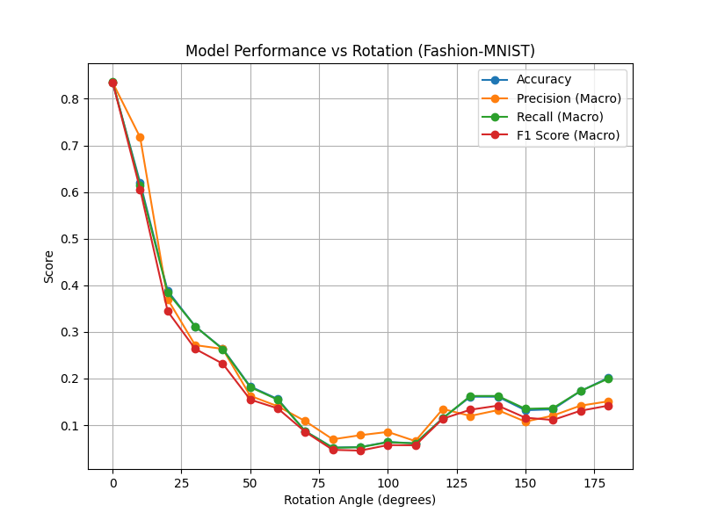
Demo and Limitations:
Basis and hyperparameters Challenges:
Hard to tune hyperparameters.
Translation & Device Sensitivity:
Rotated/shifted images or different devices can break the model; CNNs can help.
Overconfident Predictions:
Softmax outputs high confidence even for wrong inputs; model memorizes pixels, not structure.
Demo Link:
https://youtu.be/eUbyGJAqGjI
Notes:
Bibek
1. Discuss about limitation of model
2. Challenges we face during hyperparameters and youtube demo(Do not think we might have time for real demo)

Slide 7
Any Questions?

